Slide 1
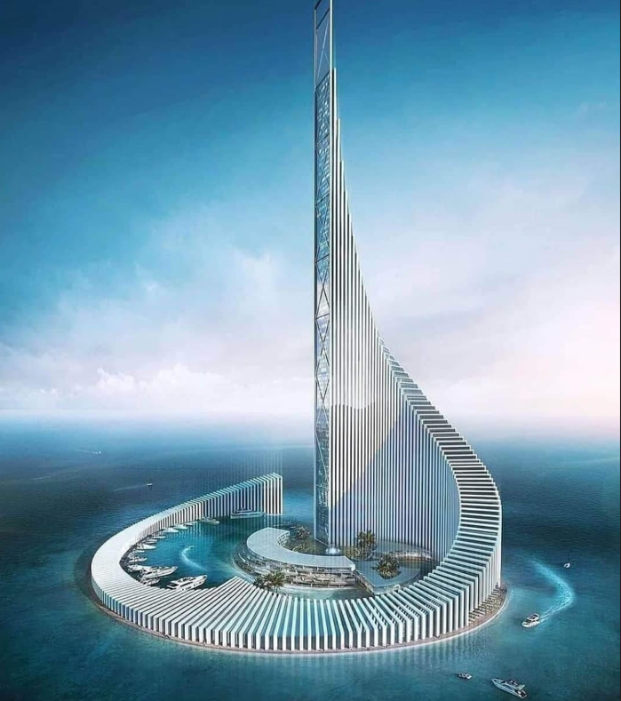
Internal funds raising
Dreams are nice; Visions are work.
Toyin Ogunlowo, 21st District Chairman

Slide 2
Table of Content
Members
Training
Events

Slide 3
MEMBERS

Slide 4
Helicopter View of Our District Potentials
Chartered Accountants that work or & live between Apogbon & Jakande Estate, Lekki
> 50 companies
> 100 companies
Telcos & FinTech and Real Estate
> 100 companies
Oil & Gas, Energy and State parastatals
> 100 firms
More than 1,000 CAs
Insurance, Trading, Hospitality & Manufacturing
More than 1,000 CAs
> 300 institutions
Professional Services Firms
More than 2,000 CAs
Banks & Financial Institutions
More than 5,000 CAs
More than 5,000 CAs

Slide 5
Our reality check
Chartered Accountants that work or & live between Apogbon & Jakande Estate, Lekki
Less than 10 companies
Less than 10 companies
Less than 10 companies
Telcos & FinTech and Real Estate
Oil & Gas, Energy and State parastatals
Less than 30 firms
Less than 20 CAs
Insurance, Trading, Hospitality & Manufacturing
Less than 10 Institutions
Less than 50 CAs
Professional Services Firms
Less than 100 CAs
Banks & Financial Institutions
Less than 300 CAs
Less than 100 CAs

Slide 6
ITEM 02
Green marketing is a practice whereby companies seek to go above and beyond traditional marketing by promoting environmental core values in the hope that consumers.
TWO-OPTION COMPARISON
Green marketing is a practice whereby companies seek to go above and beyond traditional marketing by promoting environmental core values in the hope that consumers.
WRITE YOUR SUBTITLE HERE
Industry Statistics
VS
ICAN Lagos & District
>5,000 CAs
>300 Banks
Banks
< 7 Banks
<15 members
>500 CAs
> 25 Companies
Energy, Power, Oil & Gas
50%
50%
85%
Professional Services
65%
>5,000 CAs
> 200 firms
< 75 firms
300 members
20%
Insurance
20%
>500 CAs
>25 companies
50%
50%
>500 CAs
>25 Companies
Telco & FinTech
50%
50%
90%
50%
>500 CAs
>100
Real Estate, Conglomerate
Hospitality, Parastatals
50%
75%
50%

Slide 7
Way forward
Align actions and decisions: it took our District 56 years to grow financial membership to slightly over 500. Having a shared vision helps us to team up and align actions and decisions to have additional 500 financial membership in one year effective from today. This ensures that everyone is working towards the same objective, which can improve productivity and effectiveness as we work toward achieving 1,000 financial membership in one year.
Promotes innovation and creativity: Members are being encouraged to think creatively, bring up innovative solutions and new ways of working together. Hence, we will create FOUR cardinal categories along industry line namely: Banking & Insurance; Energy, Oil & Gas, conglomerate & manufacturing; State parastatals, hospitality, medicare and Telco & Fintech, Media, Real Estate & Professional Services.

Slide 8
Way forward
Speak Up for clarity: Members are encouraged to always:
Speak up RESPECTFULLY
Speak up PROFESSIONALLY
Speak up HUMBLY.
Thursday Happy Hour: Lagos is the busiest city in West Africa and we are the professionals making it happening. Hence, we need to unwind and relax under a friendly atmosphere every Thursday of the Members General Meeting

Slide 9
TRAINING

Slide 10
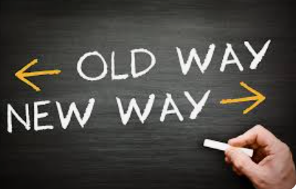
Way forward
Dreams are nice; visions are work.
The quality of our facilitators for Technical Sessions at the monthly Members General Meeting will be strictly experts, technocrats, public figures, respected professionals.
We will not compromise the quality of the facilitator nor the content of discussion.

Slide 11
Way forward
Dreams are nice; visions are work.
We shall be having Hybrid meetings for all our Technical sessions during this Chairmanship year in order to give our members, who might be on out-of-station assignments, the singular benefit of unlearning, learning and relearning through the educating, exciting & information technical session, while they carry out their official assignments for their respective organization/clients.

Slide 12
EVENT

Slide 13
Examples
Investiture Ceremony
Annual Accountants Conference
Western Zonal Conference
Catch Them Young
Presidential Dinner
An evening with the Registrar
An evening with Council Members
An evening with our Patrons & Elders

Slide 14
Examples
9. End-of-the-year Party
Young Accountants District Day (MB 3,000 and above)
Senior Fellows Day (MB Four Digits & above)
Sharing Experience Day
International Accountants Day
AGM
Etc.

Slide 15
Summary
Your EXCO is made up of technocrats with cumulative experience in excess of 200 years.
Some of the EXCO members are Partners, Directors in professional service firms, while others are holding board positions and executive roles in reputable institutions.
Be assured of our commitment to stand stronger in harmony building our dear Lagos & District Society together. We are confident of a pleasant new dawn building on good foundation of our past chairmen and raising the District banner so high with hopes and vision. We believe the Almighty God that a bright future is now more assured for all of us at ICAN Lagos & District Society

Slide 16
Thank You

